Slide 1
Urban Nature Index An Ecological Monitoring Framework Towards making cities inclusive, safe, resilient and sustainable
Adeniran Akanni
Lagos State Ministry of Environment &Water Resources
mm

Slide 2
Outline of presentation
Introduction/Background
Statement of the problem
Objectives
Methodology/Implementation Plan/Activities
Final/Preliminary Results/Outputs
Conclusion/Expected outcomes
Expected/Proposed Application Areas

Slide 3
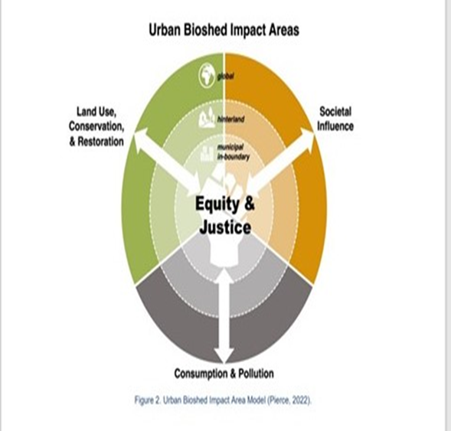
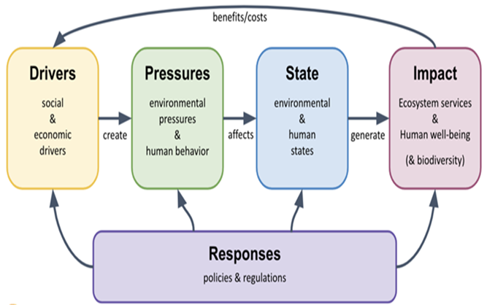
Introduction/Background

Slide 4
Objectives/Statement of the Problem
There has been a challenge of having a simple tool for measuring and monitoring natural capital by cities.
Qualitative and quantitative indicators can convey valuable information on the status and trends of natural capital stocks, the flows of services they generate, the efficacy of conservation measures and the impacts of urban consumption on nature globally.
This will in turn help in effective management of natural capital stock.
The Urban Nature Index therefore:
Aims at monitoring ecological performance in local context
Improve ecological literacy and conservation action in cities worldwide
Improvement-oriented measures capture trends over time rather than a single target
Collaborative approach harnesses existing tools and standards where possible

Slide 5
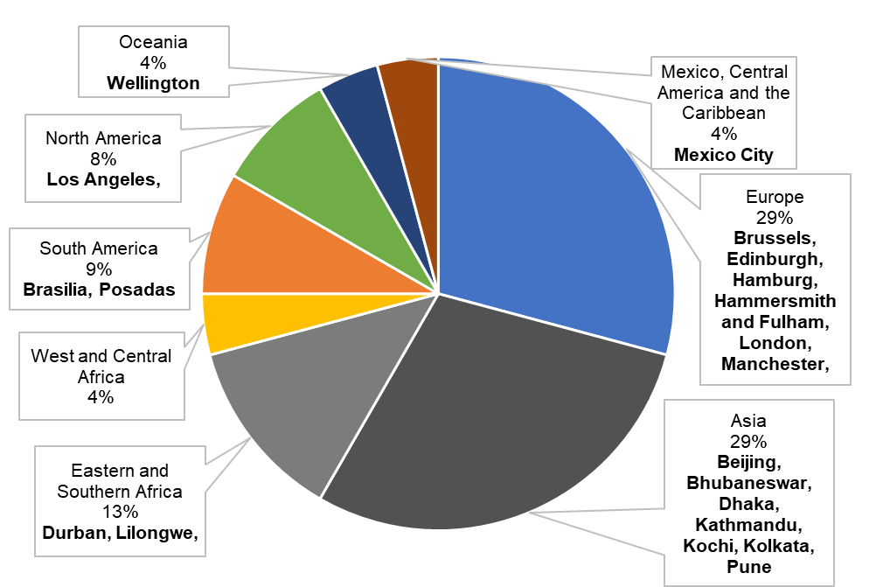
Methodology (Data & Methods), Implementation Plan/Activities
The methodology adopted in arriving at the UNI indicators include Preliminary research by members of IUC Technical Expert Group convened by IUCN Urban Alliance .
A range of relevant urban nature indices were identified and reviewed based on their respective strengths and limitations.
This was followed by convening of face to face meeting and Virtual meetings to arrive at the final set of indicators for Urban Nature Index while recognizing the dynamism and complexity of urban systems.

Slide 6
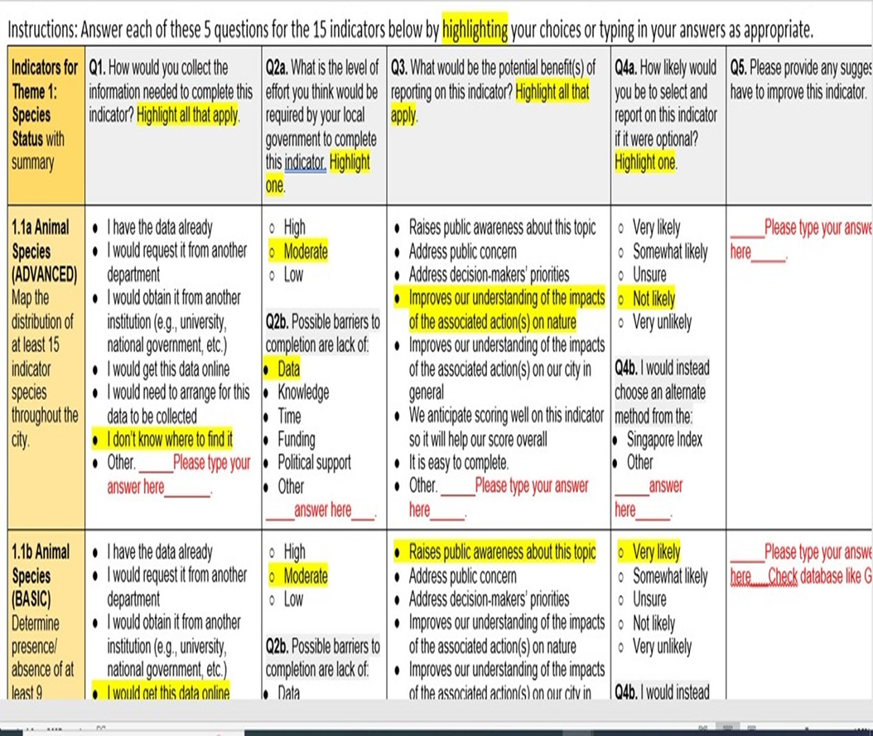

Slide 8
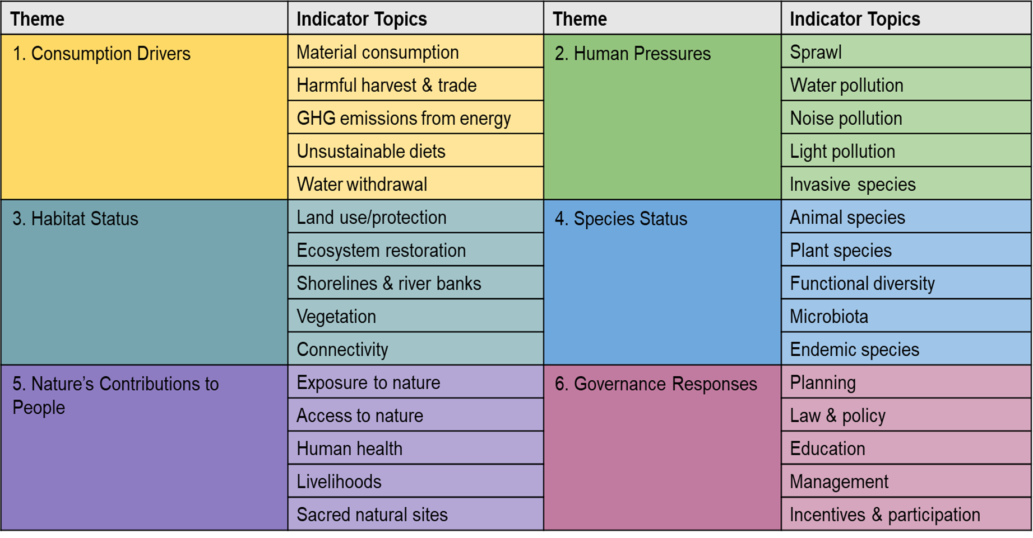
Final or Preliminary Results/Outputs

Slide 9
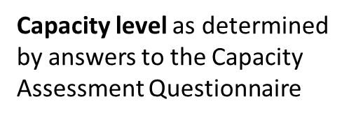
Number of indicators to adopt based on capacity level.

Slide 12
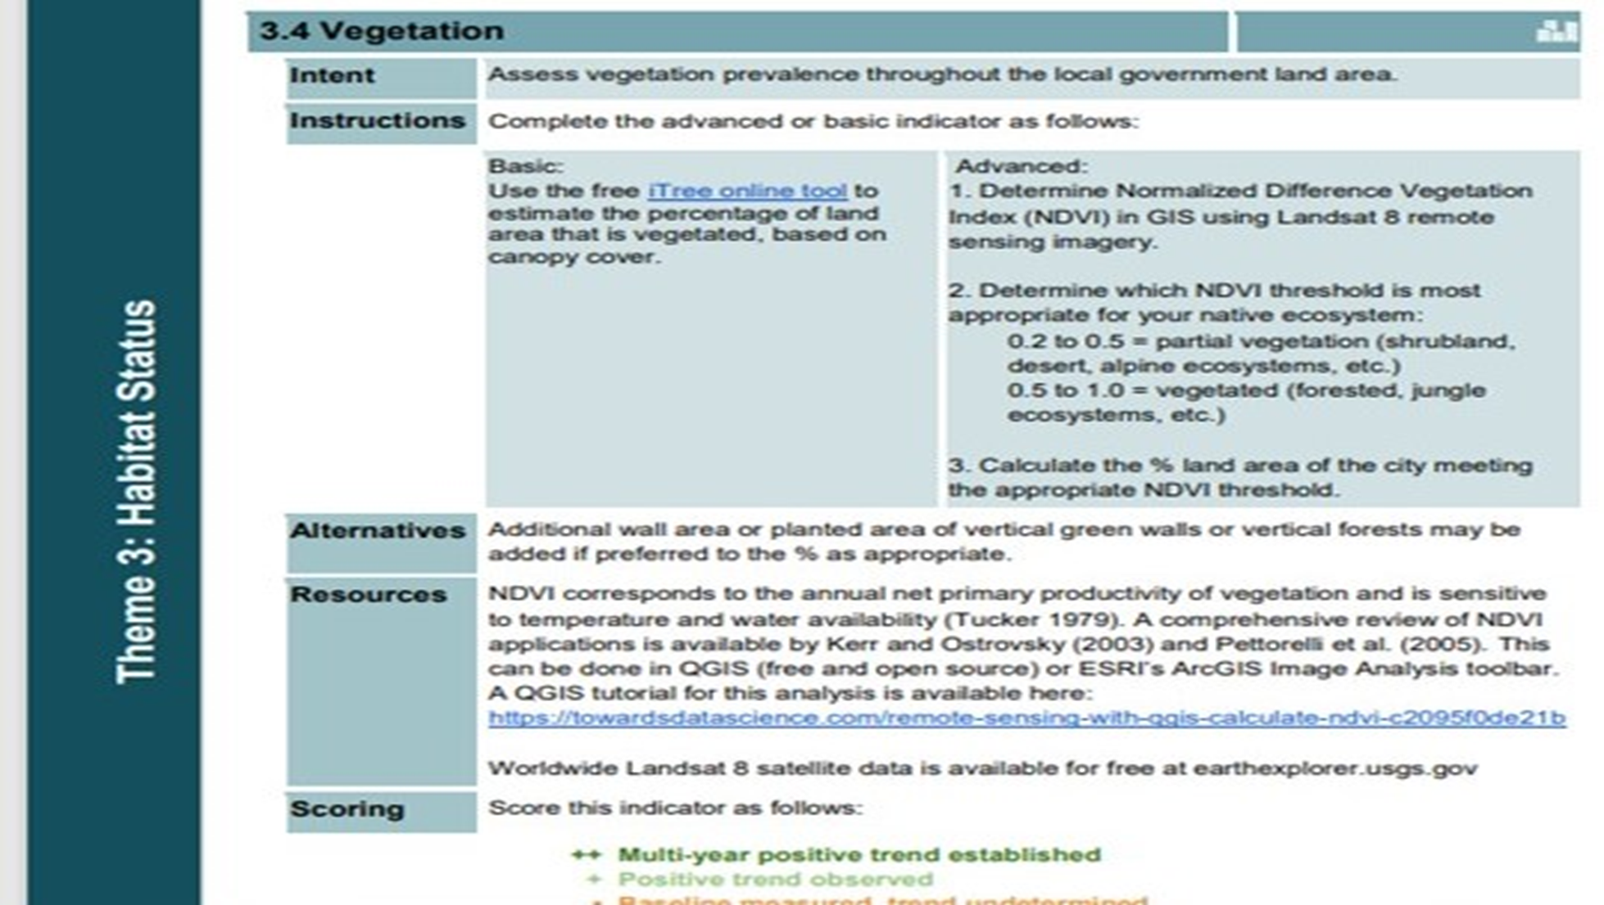

Slide 13
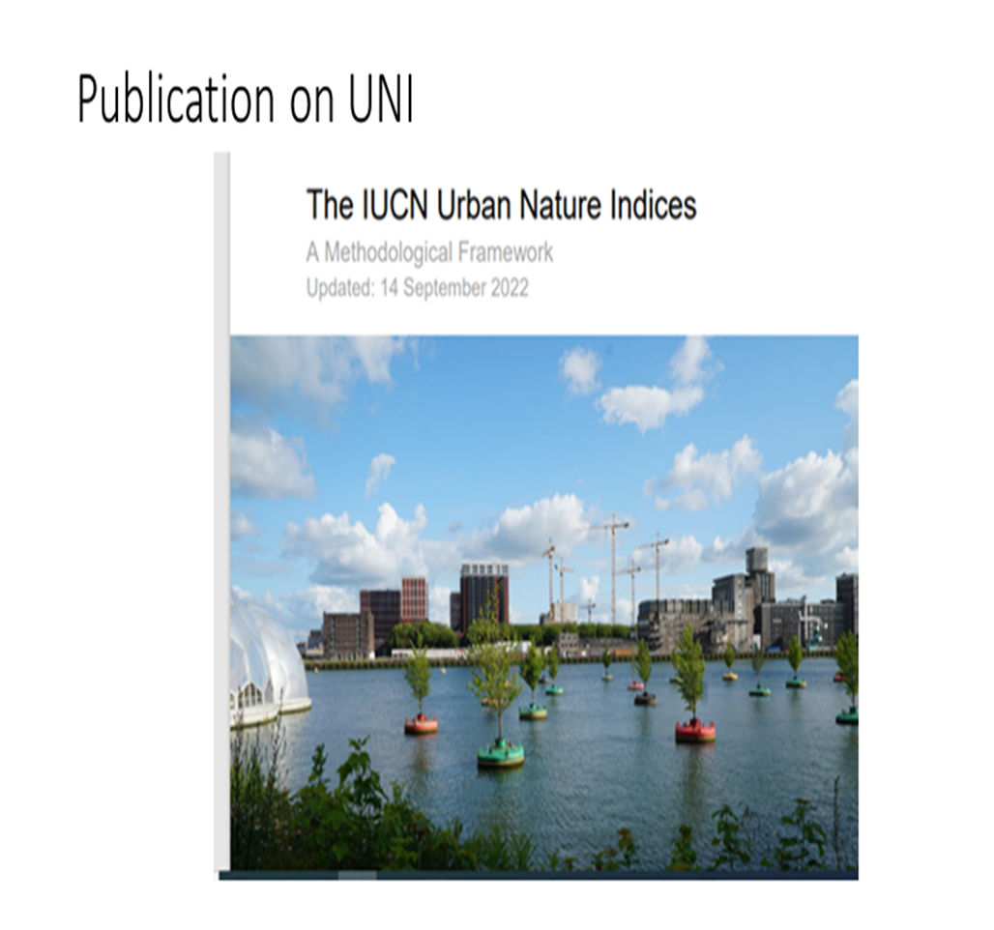
Conclusion/Expected Outcomes
-Digital Dashboard being developed to input results of city performance online
-Opportunity to collaborate with GEO task on urban resilience
-Prospect of GEO community to support with capacity building with regards to Geo-spatial data to calculate indicators like Connectivity, sprawl. Land-use, vegetation etc.

Slide 14
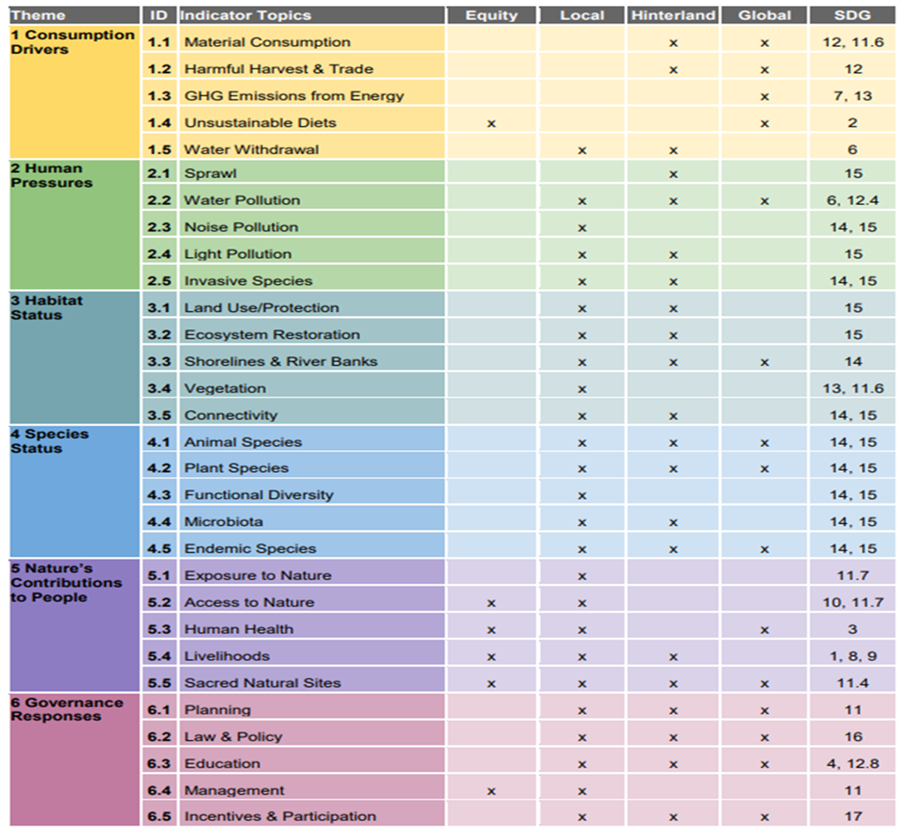
Expected/proposed application areas of the research/product/tool/service

Slide 15
Acknowledgement
^{Author 1:Adeniran Akanni1}
Author 2: Russel Galt²
Lagos State Ministry of Environment &Water Resources, Nigeria .
Email: adeniranakanni@yahoo.com
(2) IUCN Urban Alliance,
United Kingdom.
Email: russell.galt@iucn.org
Acknowledgement: Special thanks to members of IUCN Technical Group on Urban Nature Index

Slide 16
Thank you
Questions?

